Slide 1
Basic Life Support
Seyed Pouya Paknezhad, MD
Assistant professor of emergency medicine
TUOMS

Slide 2
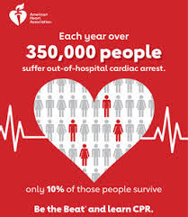

Slide 3
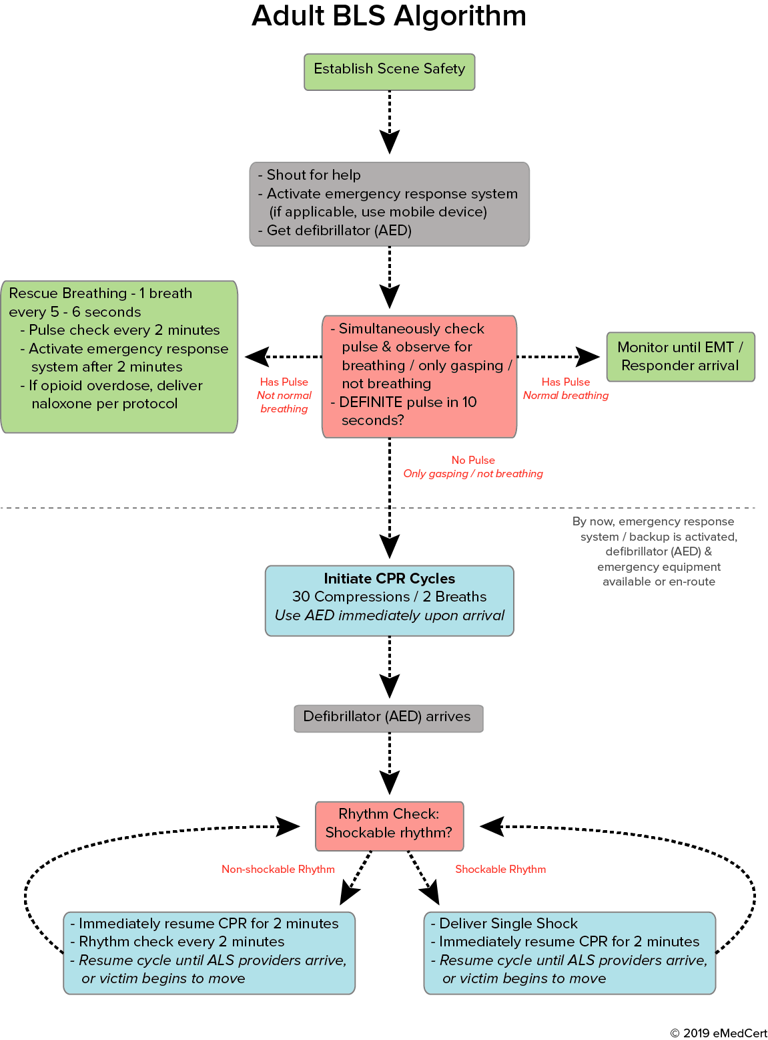

Slide 4



Slide 5
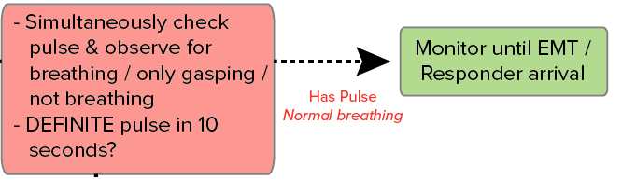

Slide 6
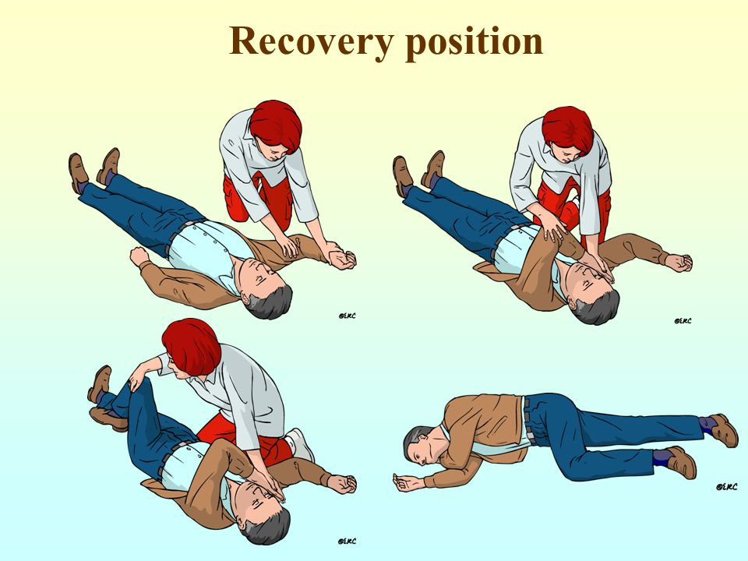

Slide 7
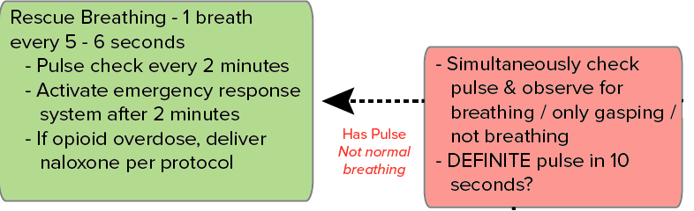

Slide 8
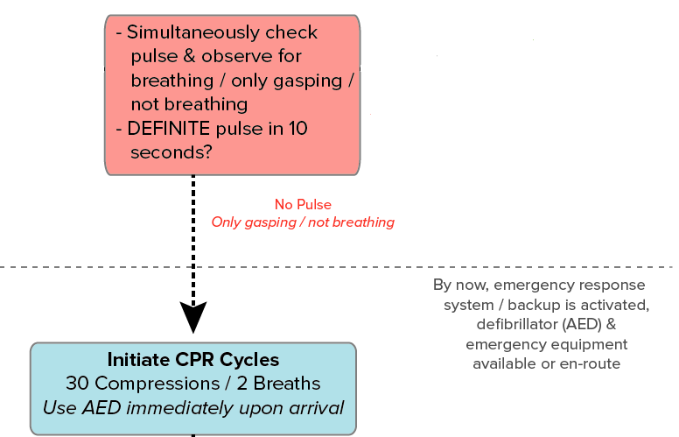

Slide 9
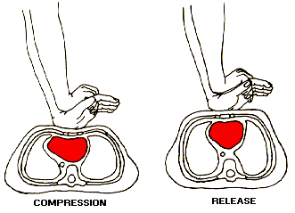
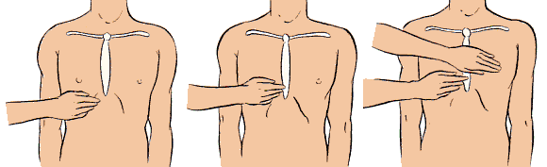
Push hard ( at least for 5 cm)
Push fast ( push for 100-120 /min )
Let the chest for recoil
Minimize interruption
Avoid hyperventilation

Slide 10
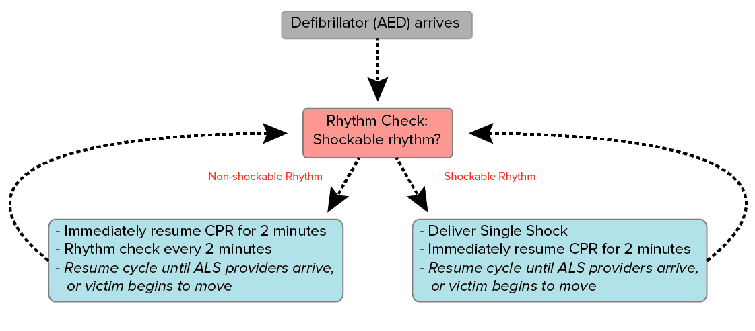

Slide 11

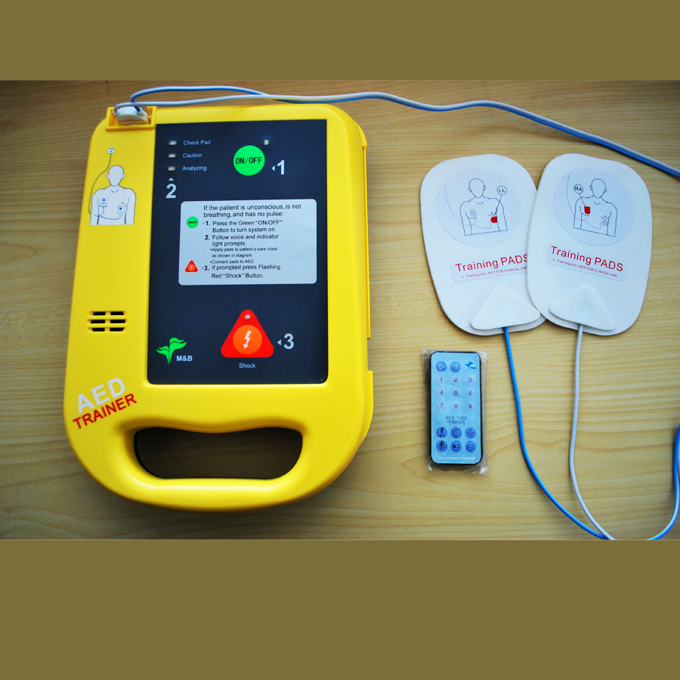
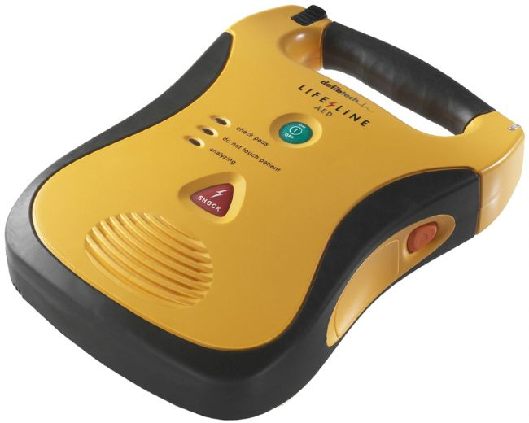

Slide 12
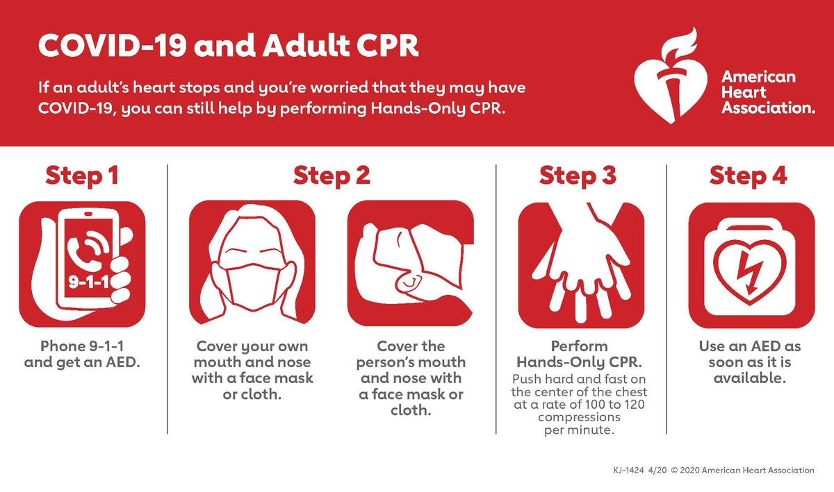

Slide 13
Questions?????

